Slide 1

https://arxiv.org/abs/1706.03762
《 Attention Is All You Need 》
Keywords: Attention mechanism, Transformer, Encoder-Decoder Architecture
DOI: https://doi.org/10.48550/arXiv.1706.03762
Presenter：Zhihong Xie
Author：Ashish Vaswani, Noam Shazeer, Niki Parmar,
Jakob Uszkoreit, Llion Jones, Aidan N. Gomez, Łukasz Kaiser, Illia Polosukhin
Presentation Time： November 12, 2024

Slide 2
01
Paper Introduction

Slide 3
01
Paper Introduction
"Attention Is All You Need" is a seminal paper in the field of natural language processing, particularly in the area of sequence transduction models. Authored by Ashish Vaswani and colleagues from Google Brain and the University of Toronto, the paper was presented at the 31st Conference on Neural Information Processing Systems (NIPS) in 2017. The paper introduces a novel neural network architecture known as the Transformer, which deviates from the traditional recurrent neural networks (RNNs) and convolutional neural networks (CNNs) by relying entirely on attention mechanisms to draw global dependencies between an input and an output sequence.

Slide 4
01
Paper Introduction
The Transformer model is not only simpler than its predecessors but also more parallelizable, which significantly reduces the training time. This breakthrough architecture has since become the cornerstone for many state-of-the-art models in various natural language processing tasks, including machine translation, text summarization, and question-answering systems.
One of the key innovations of the Transformer is the use of self-attention, which allows the model to weigh the relevance of different words within a sentence regardless of their distance from each other. This mechanism is particularly effective in capturing the context and nuances of language, leading to improved performance in tasks that require an understanding of the overall structure and meaning of text.

Slide 5
01
Paper Introduction
The paper demonstrates the effectiveness of the Transformer through extensive experiments on machine translation tasks, where it outperforms previous models in terms of quality while requiring less computational resources. The authors also show that the Transformer can be successfully applied to other tasks, such as English constituency parsing, both with large and limited training data.
"Attention Is All You Need" has had a profound impact on the field of artificial intelligence, sparking a shift towards attention-based models and opening up new avenues for research in efficient and effective processing of sequential data.

Slide 6
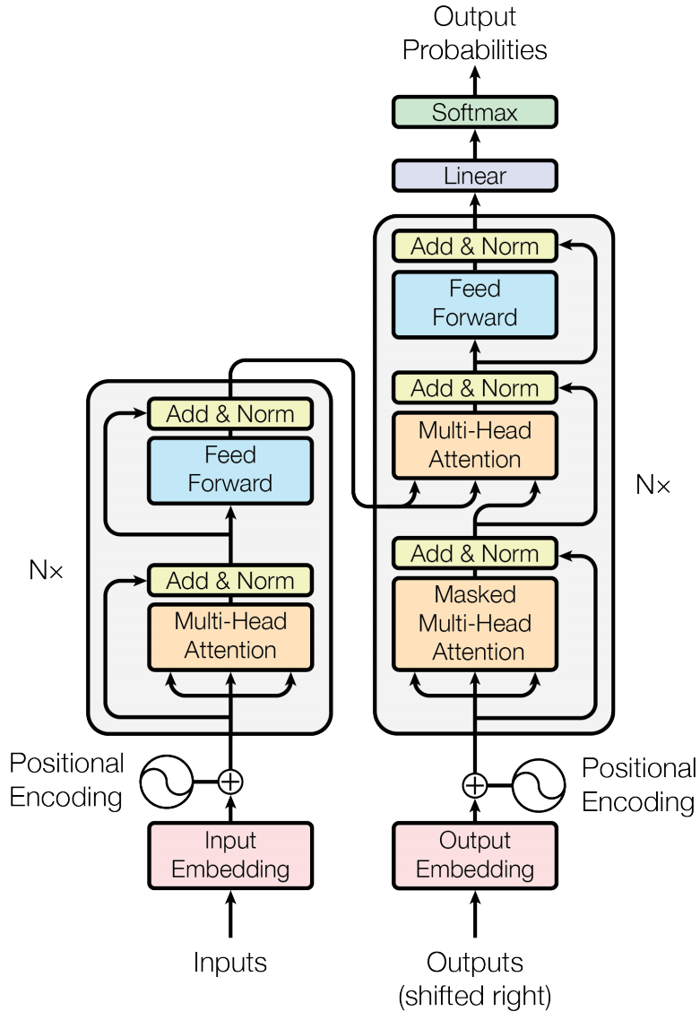
01
Paper Introduction
Encoder:
The encoder takes in a sequence of input tokens and converts them into a continuous representation using input embeddings.
Positional encoding is added to the input embeddings to provide the model with information about the order of the sequence.
The encoder consists of a stack of identical layers, each with two sub-layers:
Multi-Head Attention: This allows the model to focus on different parts of the input sequence simultaneously and weigh their importance.
Feed Forward: A fully connected feed-forward network that processes each position in the sequence separately.
Notes:
The image depicts the architecture of a Transformer model, which is a type of neural network primarily used in natural language processing tasks. The Transformer is based on the idea of attention mechanisms and is composed of an encoder and a decoder.

Slide 7
01
Paper Introduction
Decoder:
The decoder also has a stack of identical layers, but each layer has three sub-layers:
Masked Multi-Head Attention: This prevents the model from attending to future positions in the sequence, maintaining the auto-regressive property of the model.
Multi-Head Attention: Similar to the encoder, but here the queries come from the previous decoder layer, and the keys and values come from the output of the encoder.
Feed Forward: The same type of feed-forward network as in the encoder.
The decoder also uses residual connections and layer normalization after each sub-layer.
Notes:
The image depicts the architecture of a Transformer model, which is a type of neural network primarily used in natural language processing tasks. The Transformer is based on the idea of attention mechanisms and is composed of an encoder and a decoder.

Slide 8
02
sentence parsing

Slide 9
02
sentence parsing
We propose a new simple network architecture, the Transformer, based solely on attention mechanisms, dispensing with recurrence and convolutions entirely.
Transformer: a deep learning architecture based on the multi-head attention mechanism
释义：一个基于多头注意力机制的深度学习框架
Attention Mechanism: a machine learning method that determines the relative importance of each component in a sequence relative to the other components in that sequence.
释义：一种机器学习方法，用于确定序列中每个组件相对于该序列中其他组件的相对重要性

Slide 10
02
sentence parsing
Recurrent neural networks, long short-term memory and gated recurrent neural networks in particular, have been firmly established as state of the art approaches in sequence modeling and transduction problems such as language modeling and machine translation.
Recurrent neural networks: a class of artificial neural network commonly used for sequential data processing.
释义：一类通常用于顺序数据处理的人工神经网络
long short-term memory: Long short-term memory (LSTM)[1] is a type of recurrent neural network (RNN) aimed at mitigating the vanishing gradient problem[2] commonly encountered by traditional RNNs.
释义： 是一种递归神经网络 （RNN），旨在缓解传统 RNN 常见的梯度消失问题
state of the art：常用的术语，用来描述在某个领域或技术中当前最先进、最有效的方法或技术。它代表了该领域内的最高水平
machine translation: is use of computational techniques to translate text or speech from one language to another
释义：机器翻译是使用计算机技术将文本或语音从一门语言翻译到另一门语言
Notes:
RNNs Unlike feedforward neural networks, which process data in a single pass, RNNs process data across multiple time steps, making them well-adapted for modelling and processing text, speech, and time series.[

Slide 11
02
sentence parsing
The first is a multi-head self-attention mechanism, and the second is a simple, position wise fully connected feed-forward network.
multi-head self-attention mechanism: a type of attention mechanism used in deep learning for processing sequence data. This mechanism allows the model to focus on different parts of the input sequence in different representation subspaces at the same time
释义：多头注意力机制主要用于处理序列数据，这个机制允许模型同时在不同的子空间关注输入蓄力的不同部分
position wise: "position-wise" in the context of deep learning and neural networks refers to operations that are applied independently to each position in a sequence
释义：position-wise 即“逐位操作”，是指对序列中矩阵中的每个位置或者某一行或列独立应用某种操作，在并行运算的时候非常有用
fully connected feed-forward network: a type of artificial neural network where every node in one layer is connected to every node in the next layer.
释义：全连接网络也叫作“多层感知机”, 是指神经网络中某一层的节点与下一层的节点都存在连接

Slide 12
02
sentence parsing
We also use the usual learned linear transformation and softmax function to convert the decoder output to predicted next-token probabilities.
linear transformation: a function between two vector spaces that preserves the operations of vector addition and scalar multiplication
释义： 两个向量空间之间的函数，它保持了向量加法和标量乘法的操作
softmax: maps a vector or matrix of real numbers to another vector or matrix where each element is between 0 and 1, and the sum of all elements is 1.
释义：常见的激活函数，用来从一个向量或矩阵映射到另一个向量或矩阵，确保每个元素都是在[0, 1]， 并且相加之和为 1
token: In NLP, a "token" refers to a basic unit of text.
释义：在自然语言处理中，一个 token 代表的就是文本的一个基本单元

Slide 13
02
sentence parsing
To this end, we add "positional encodings" to the input embeddings at the bottoms of the encoder and decoder stacks.
positional encoding: a method of providing positional information to the model about the sequence of words.
释义：位置编码是在为序列单词建模过程中提供位置信息的一种方法
embedding: discrete objects, such as words or tokens in a sequence, are converted into continuous vectors of real numbers.
释义：在这篇论文中，embedding 表示将离散的对象转换为实数的连续的连续向量表示。
encoder: processes the input sequence, converting each input element (such as words or tokens) into a series of continuous representations that capture the semantic and syntactic information of the input data.
释义：处理输入序列，并将每个输入元素（如单词或标记）转换为一系列连续的表示
decoder: a componet that is responsible for generating the output sequence.
释义：和 Encoder 类似，都是 Transformer 中的一个组件，用于处理生成输出序列

Slide 14
02
sentence parsing
For the base models, we used a single model obtained by averaging the last 5 checkpoints, which were written at 10-minute intervals.. These hyperparameters were chosen after experimentation on the development set.
checkpoint: a snapshot of the model's state saved during the training process.
释义： 在训练过程中保存的模型状态的快照，通常包括模型的权重、优化器的状态、训练的进度等
interval: a period of time.
释义：每次保存的时间间隔
hyperparameters: parameters that are set before the learning process begins, in contrast to the parameters that the model automatically adjusts during learning
释义：在开始学习过程之前设置的参数，与模型在学习过程中自动调整的参数不同，通常来说，超参数都是自己手动设置的
development set: also called as validation set, a dataset used in machine learning to adjust hyperparameters and to prevent overfitting.
释义：开发集也叫验证集，是机器学习中用于调整超参数和避免过拟合的数据集

Slide 15
Thanks for listening !

